Slide 1
Coca-Cola Stock Prediction
Data Analysis Insights

Slide 2
Introduction
Analyzing Coca-Cola’s stock performance to uncover market trends and investor insights.
Why? To understand price movements, volatility, and trading patterns using historical data.
Scope: 1962–2022 stock data, focusing on analytics for strategic decisions.

Slide 3
Objectives
15311
Calculate key metrics (average prices, returns, volatility)
Visualize trends with moving averages and volume.
Explore trading patterns and market reactions.
Provide actionable insights for investors.

Slide 4
Dataset Overview
5997
Source: Coca-Cola stock history (1962–2022).
Columns: Date, Open, High, Low, Close, Volume, Dividends, Stock Splits.
A rich dataset capturing six decades of market behavior.
Stats:
Trading Days: ~5,997.
Avg. Close: ~$7.39.
Avg. Volume: ~8.17M shares.

Slide 5
Data Cleaning
Checked for missing values: None found.
Converted ‘Date’ to datetime format
Adjusted prices for dividends and splits (data pre-adjusted).
"Clean data ensures reliable analysis."

Slide 6
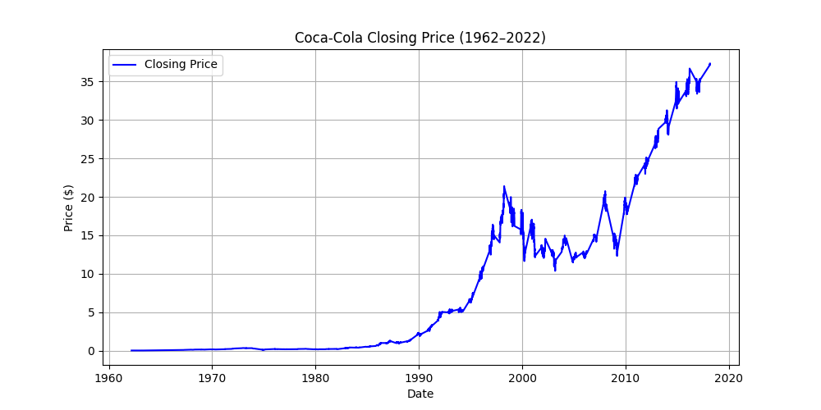
Closing Price Trend
Steady growth with dips in 2008 and 2020, reflecting market events.

Slide 7
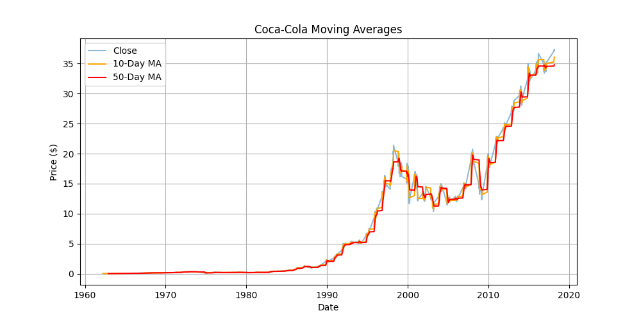
Moving Averages
Graph: Closing price with 10-day and 50-day MAs.
10-day MA tracks short-term swings; 50-day MA shows longer trends.

Slide 8
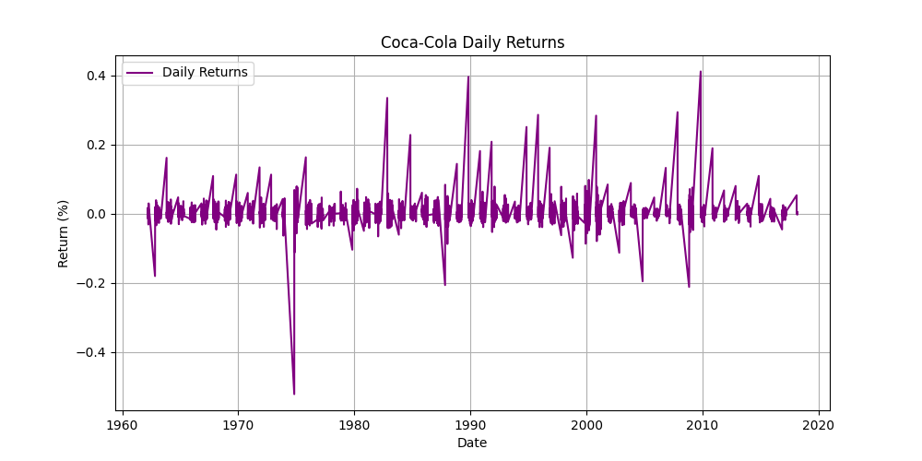
Daily Returns
Graph: Daily returns (Close price % change).
"Returns fluctuate, with larger swings during crises (e.g., 1987, 2008)."

Slide 9
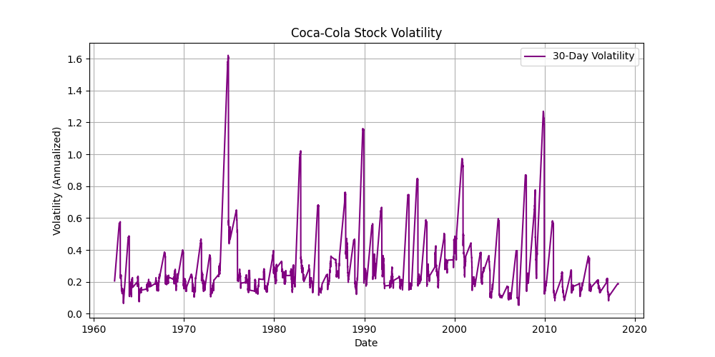
Volatility Analysis
Graph: 30-day rolling volatility.
"Spikes in 1987, 2008, 2020—times of market stress."

Slide 10
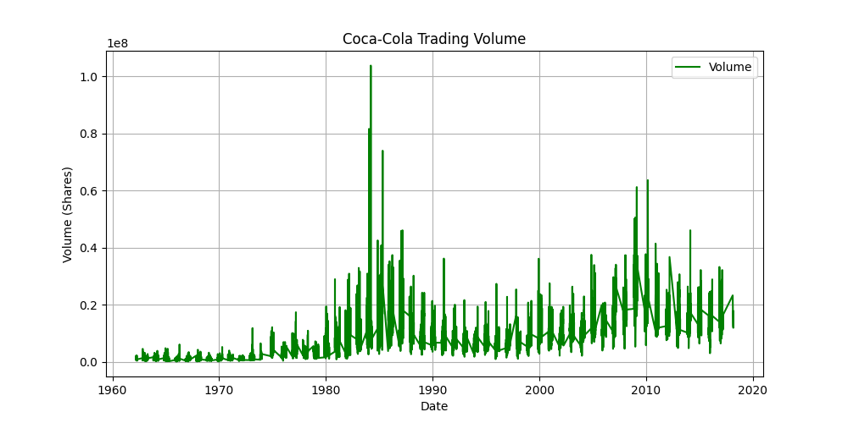
Trading Volume
Graph: Volume over time.
"Volume surges during market events (e.g., 2008, 2020)."

Slide 11
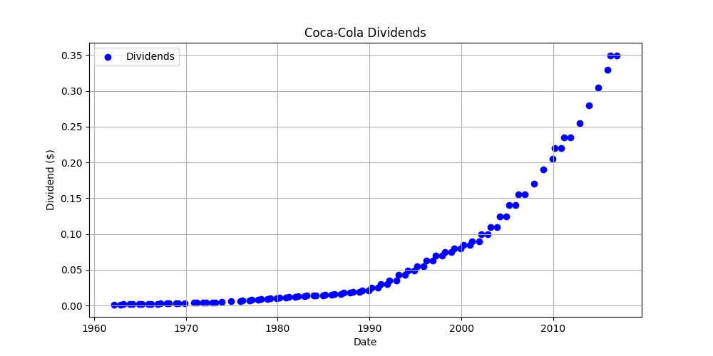
Dividends Impact
Graph: Dividend payments over time.
"Regular dividends add value, with increases over decades."

Slide 12
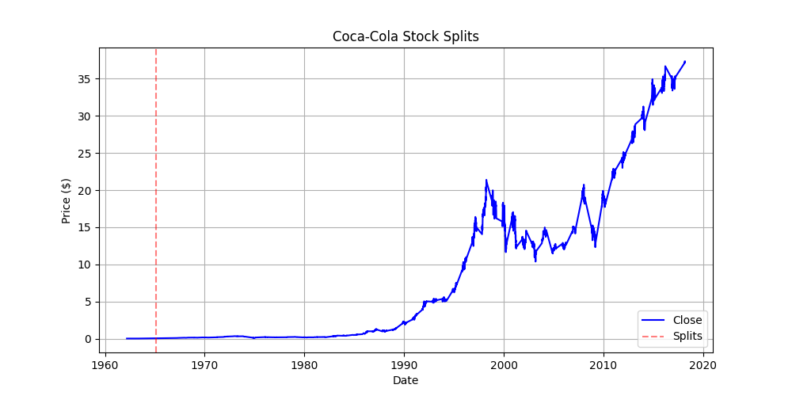
Stock Splits
Graph: Mark stock split dates.
"Splits (e.g., 1962, 1977) adjust prices for accessibility."

Slide 13
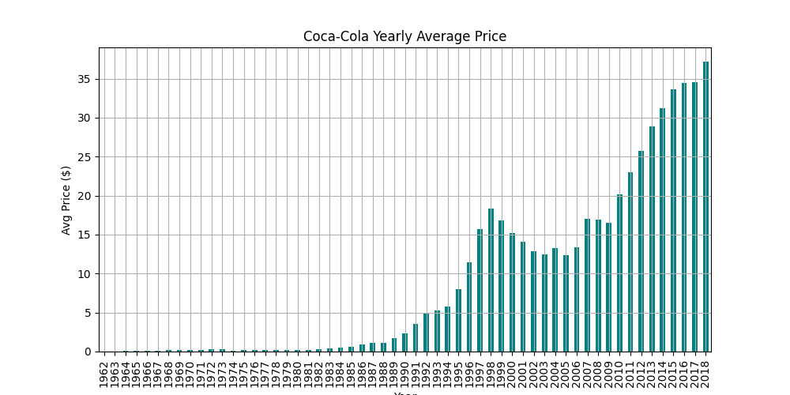
Yearly Performance
Graph: Average closing price by year.
"Consistent growth, with plateaus in tough markets."

Slide 14
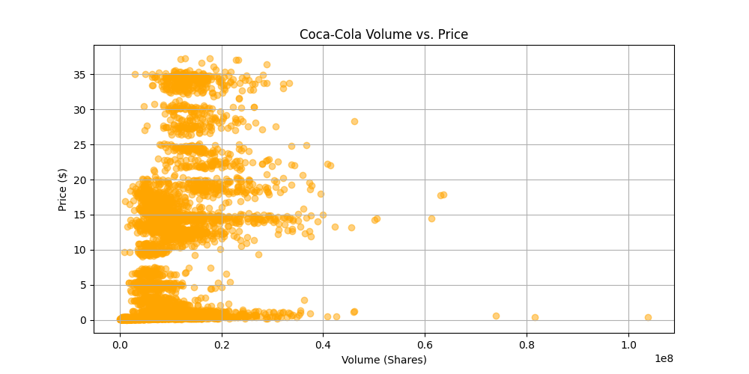
Volume vs. Price
Graph: Scatter of volume vs. closing price.
"High volume often ties to price jumps or drops."

Slide 15
Key Insights
Steady price growth, avg. ~$15.62 over 60 years.
Volatility spikes in crises (1987, 2008, 2020).
Volume surges signal market reactions.
Dividends and splits boost long-term value.

Slide 16
Investor Takeaways
Use moving averages to spot trends.
Watch volume for big moves.
Volatility signals risk—stay cautious in crises.
Dividends make Coca-Cola a solid hold.

Slide 17
Challenges
Long-term data includes old, less relevant periods.
Volume spikes can mislead without context.
Volatility tough to predict without external data.
"Analytics needs market news for full picture."

Slide 18
Conclusion
"Coca-Cola’s stock shows resilience and growth, perfect for analytics."
"Visuals and metrics reveal trends for smart investing."
"Future work: Add real-time data and news sentiment."

Slide 19
Thank you

